Slide 1


Serverless Notification System
Event-Driven Cloud-Based Alert System
This project is a cloud-based notification system that allows users to send messages instantly through email. It is built using AWS serverless technologies and provides a simple and efficient way to automate communication.
Under the Department of Computer Science and Engineering (Specialization in Cloud and Edge Computing)
M/s. G. Lavanya & G Madhu
Team Members Names
Dundigal Mahith - 2320030165
Kalisiti Jayakrishna - 2320030191
M Sathvik Reddy - 2320030162
B Kushal - 2320030214

Slide 2
Problem
In many situations, communication is still done manually, which causes delays and inefficiency. Important messages like announcements or updates do not reach users on time, especially when dealing with multiple recipients.

Slide 3
Solution
To solve this, we developed a smart notification system that automates message delivery. Users can enter details and send notifications instantly without any manual effort or delay.

Slide 4
Concept
This project is based on a serverless and event-driven approach. Whenever a user performs an action, it triggers a process in the backend that automatically sends the notification without needing a dedicated server.

Slide 5
Technologies
The system uses AWS Lambda for backend processing, API Gateway to handle requests, and AWS SES for sending emails. The frontend is built using HTML, CSS, and JavaScript, and hosted on Amazon S3.

Slide 6
Working
When a user enters an email, subject, and message, the request is sent to an API. This API triggers a Lambda function, which then uses AWS SES to send the email. The entire process happens in seconds.

Slide 7
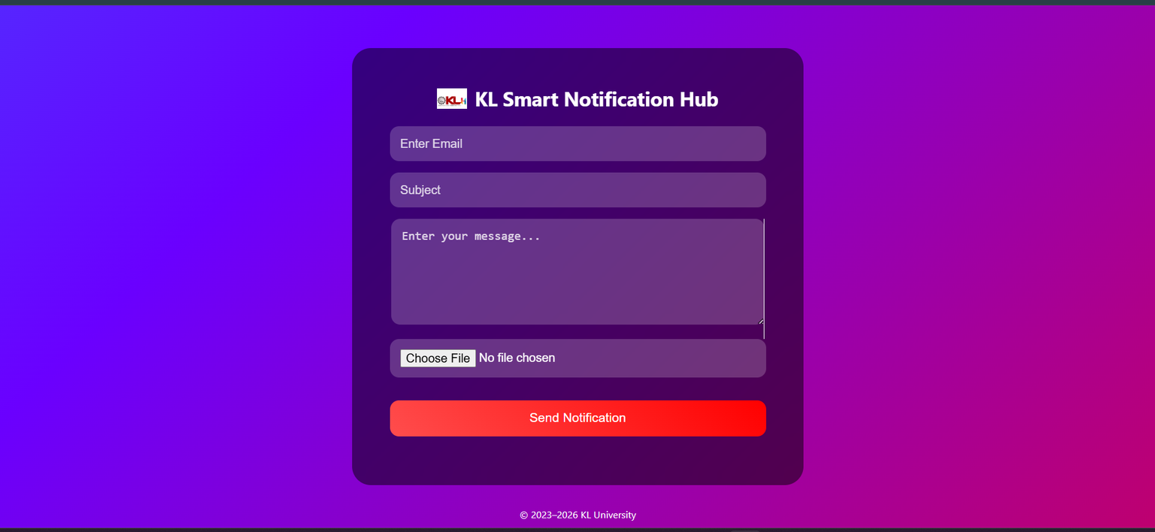
Sample Interface
Link

Slide 8
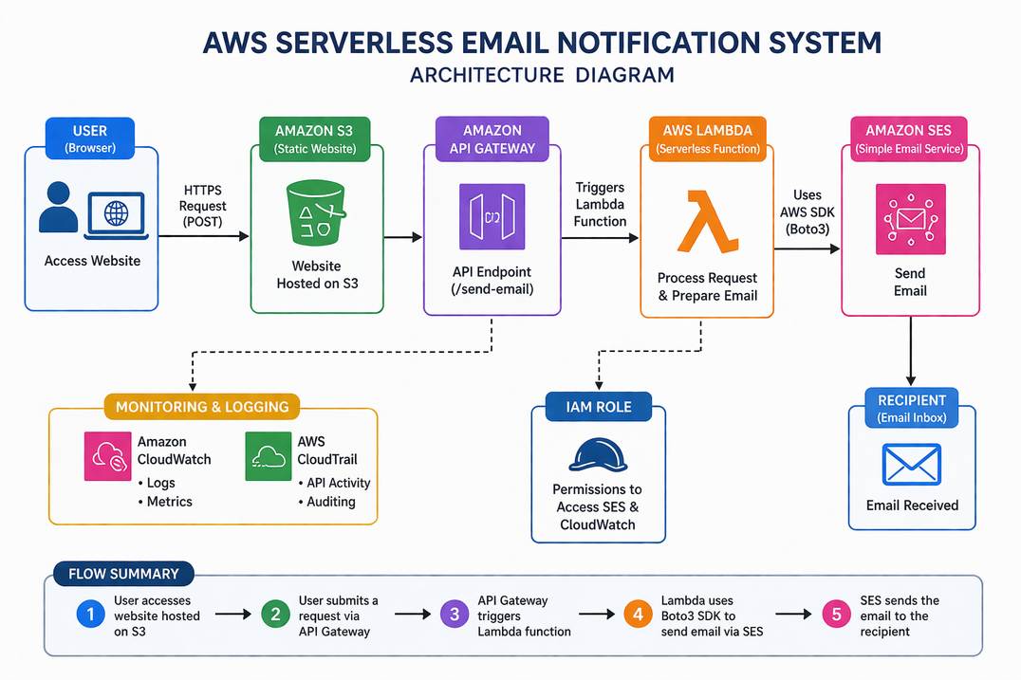
Architecture
The system consists of a frontend interface connected to an API Gateway. The API triggers a Lambda function, which communicates with AWS SES to send the email. This setup removes the need for managing servers.

Slide 9
Features
The system allows real-time email notifications with a simple interface. It is scalable, easy to use, and fully cloud-based, making it efficient for both small and large use cases.

Slide 10
Challenges
During development, we faced issues such as email restrictions in AWS SES sandbox mode and API connection errors. These were resolved by verifying emails and properly configuring the API.

Slide 11
Future Scope
In the future, this system can be enhanced by adding bulk email support using CSV files, integrating SMS notifications, and building a mobile application for better accessibility.

Slide 12
Thank You

